Slide 1

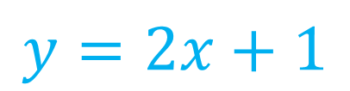


Algebra Interactive Notebook
$$3ab$$
$$\frac{5xy}{6}$$
Name :
Class :
Term 1 Semester 1
$$2x+3y$$
$$y=2x+1$$

Slide 2
Contents
Glossary
Page
Date
Description
2
3

Slide 3
Tasks
24
7
30
Essential Question
Questions
Notes
Summary
4
7

Slide 4
Simplifying Expressions
24
7
30
EQ: What is a ‘like term’ and how do I collect them?

Slide 5

Simplifying Expressions
24
7
30
EQ: What is a ‘like term’ and how do I collect them?
Glossary terms
constant
variable
coefficient
A number with nothing else attached to it
Eg: $1, 2, 5, 47, 936$
A letter that represents an unknown number
Eg: $a, b, x, y$
The number in front of the variable
Eg: $3x 3 is the coefficient$
$5y 5 is the coefficient$

Slide 6

Simplifying Expressions
24
7
30
EQ: What is a ‘like term’ and how do I collect them?
What is a like term?
Like terms are the terms that have the same variables
$3x 5y 7xy 4x 6y 3yx 8y$
Group the above into ‘like terms’:
$$3x, 4x$$
$$5y, 6y, 8y$$
$7xy, 3yx$ $7xy, 3xy$ ALWAYS IN ALPHABETICAL ORDER!

Slide 7
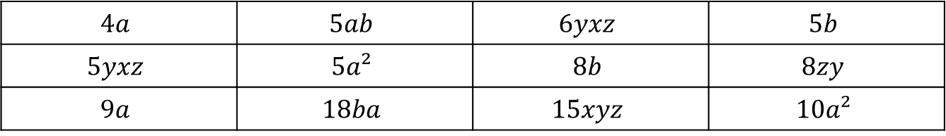
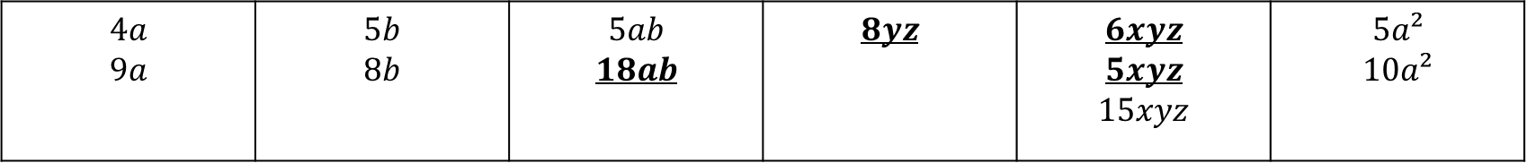
Practice: lhs
GROUP THE FOLLOWING INTO LIKE TERMS
$$4a$$ | $$5ab$$ | $$6yxz$$ | $$5b$$
$$5yxz$$ | $$5a²$$ | $$8b$$ | $$8zy$$
$$9a$$ | $$18ba$$ | $$15xyz$$ | $$10a²$$
$$4a$$ $$9a$$ | $$5b$$ $$8b$$ | $$5ab$$ $$18ab$$ | $$8yz$$ | $$6xyz$$ $$5xyz$$ $$15xyz$$ | $$5a²$$ $$10a²$$

Slide 8
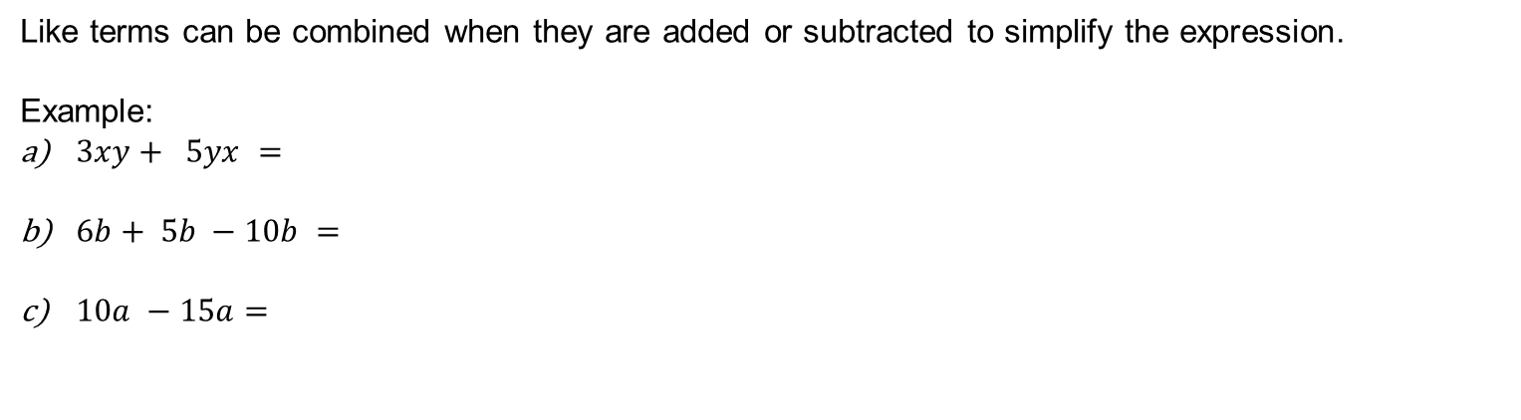
Simplifying Expressions
24
7
30
EQ: What is a ‘like term’ and how do I collect them?
How do I add and subtract like terms?
Like terms can be combined when they are added or subtracted to simplify the expression.
Example:
$3xy+ 5yx =$
$6b+ 5b −10b =$
$10a −15a=$

Slide 9
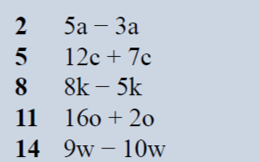
Practice: lhs
2a
19c
3k
18o
-w

Slide 10

Simplifying Expressions
24
7
30
EQ: What is a ‘like term’ and how do I collect them?
How do I add and subtract like terms?
Like terms can be combined when they are added or subtracted to simplify the expression.
Example:
$3xy+ 5xy =$
$6b+ 5b −10b =$
$10a −15a=$
$3x+7y −2x +3y=$

Slide 11


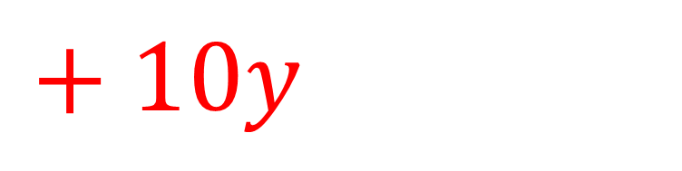
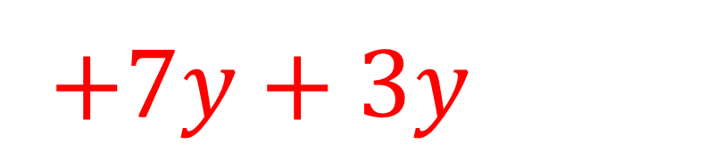

$$3x+7y −2x +3y$$
$$3x−2x$$
$+7y+3y$
$x$
$+ 10y$

Slide 12
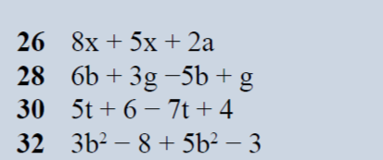

Practice: lhs
$13x+2a$
$$b + 4g$$
$$−2t+10$$
$$8b^{2}−11$$

Slide 13
Task

Slide 14
Answers

